Slide 1
Spark Languages Scala vs Python

Slide 2
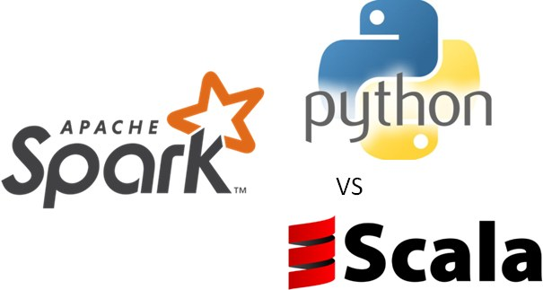
Scala Vs Python
Performance

Slide 3
Scala Vs Python
Performance
Enterprise Acceptance

Slide 4
Scala Vs Python
Performance
Enterprise Acceptance
Learning Curve

Slide 5
Scala Vs Python
Performance
Enterprise Acceptance
Learning Curve
Machine Learning Libraries

Slide 6
Scala Vs Python
Performance
Enterprise Acceptance
Learning Curve
Machine Learning Libraries
Type safety

Slide 7
Scala Vs Python
Performance
Enterprise Acceptance
Learning Curve
Machine Learning Libraries
Type safety

Slide 8
Scala Vs Python
Performance
Enterprise Acceptance
Learning Curve
Machine Learning Libraries
Type safety
Visualization Libraries

